Slide 1
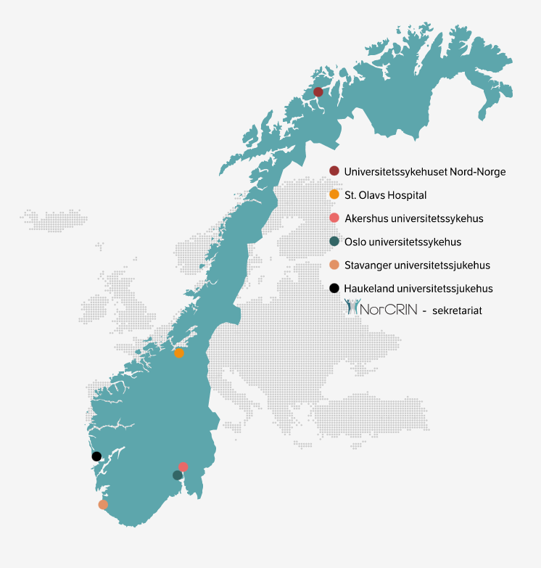

What is NorCRIN?
Norwegian Clinical Research Infrastructure Network
6 University Hopitals – one national network for research infrastructure
2011: Assignment from Norwegian Ministry of Health and Care Sevices – Norwegian node in ECRIN: www.ecrin.org
2012: establishment of the NorCRIN secretariat
2014: Initial establishment of the consortium agreement
with 6 partners
2015-2020: 50 MNOK from the Research Council of Norway (RCN) to NorCRIN1-project
2020-2025: 50 MNOK from RCN to NorCRIN2-project
2025-2028: NorCRIN2 (funded by partners' own contributions)

Slide 2
Why do we need NorCRIN?
Main objectives:
Strengthen collaboration and synergies within clinical research in Norway
Contribute to increased quantity and quality of research by harmonizing procedures and agreements
Develop support tools for best practices and standard operating procedures (SOPs)
Contribute to capacity building in clinical research environments
Safeguard Norway’s position in European clinical research
Facilitating more research, enhanced quality, and reduced administrative burden

Slide 3
NorCRIN Organisational Chart
Scientific Advisory Board
NorCRIN Board
RCN
User representative
User Advisory Board
ECRIN
HUS
NorCRIN-arbeidspakker
NorCRIN-arbeidspakker
NorCRIN
secretariat
NorCRIN
Work Packages
UNN
StOlav
SUS
Ahus
OUS
HUS

Slide 4



NorCRIN – Advisory Services and Deliverables
Protocol writing
Financing / Funding
Applications (NoMA, CTIS, REC)
Contracts / Legal
Clinical Trial Units
Data Capture Tools
Monitoring
SUSAR Reporting
Reseach Networks
Clinical Trials Day
Protocol Template
SOPs (Standard Operating Procedures)
Roles & Responsibilities
Implementation & Conduct:
- Clinical drug trials
- Medical devises
- Other interventions
Data Management
Statistics
Teaching courses:
- GCP
- statistics
- clinical trial nurse
- medical devises
Seminars:
- monitoring
- data management
- user involvement
- safety reporting
Research support
Procedures
Competence

Slide 5
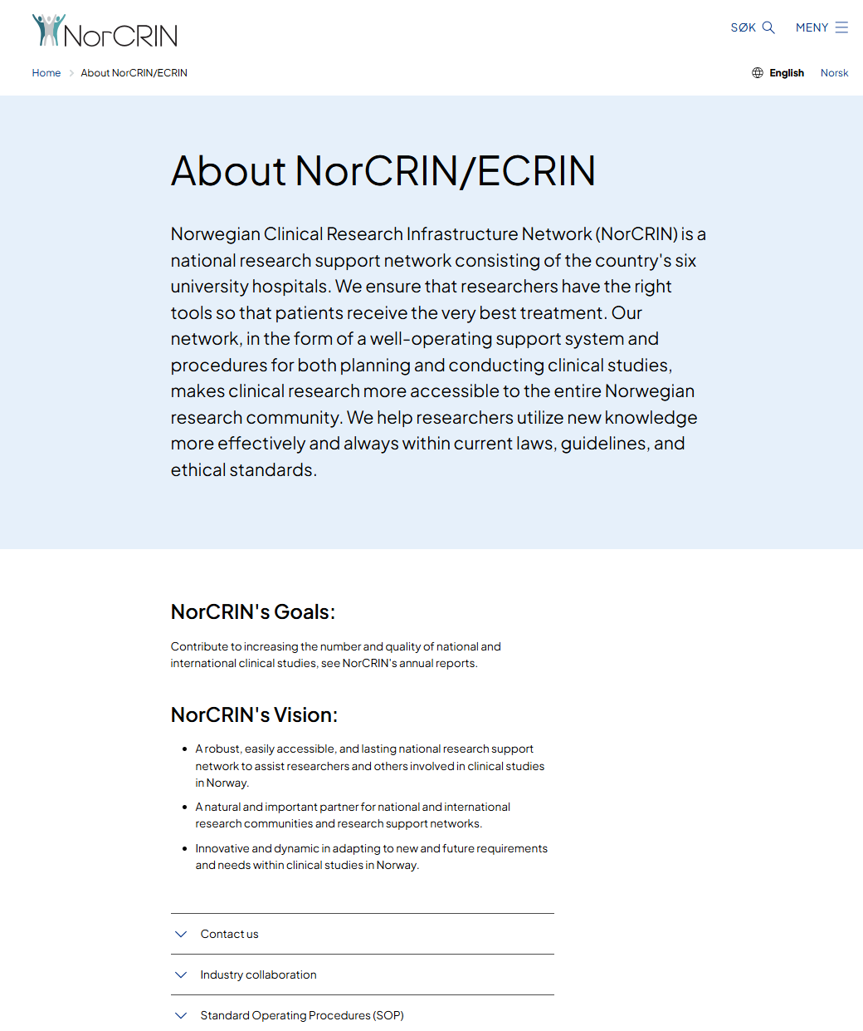
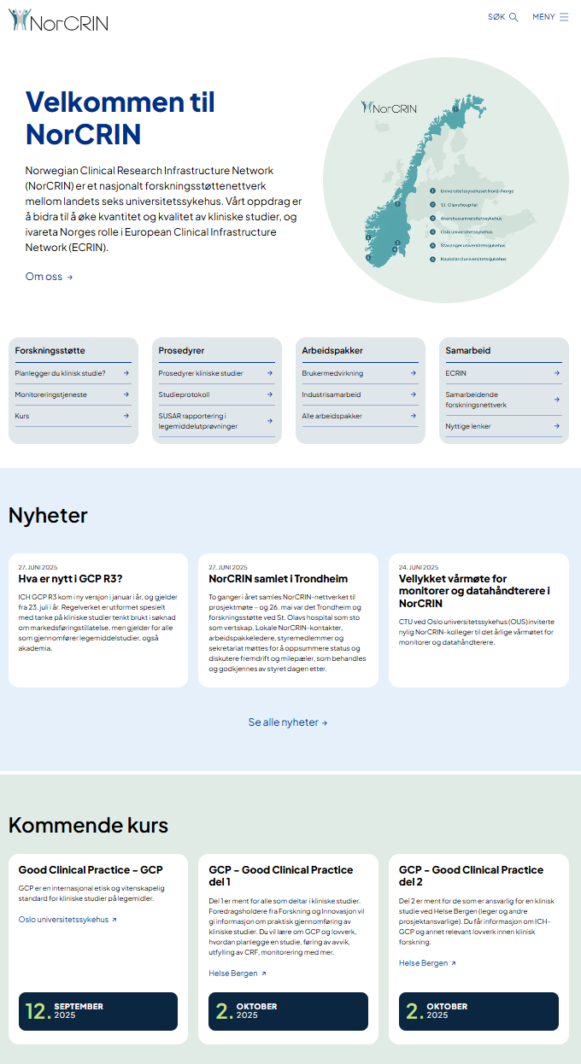
NorCRIN – on the web (FNSP)
www.norcrin.no

Slide 6

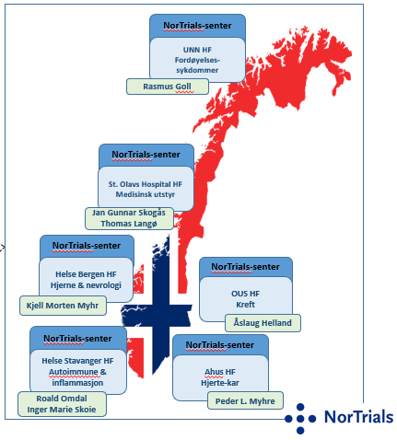
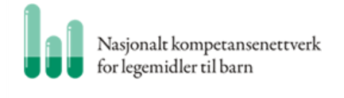

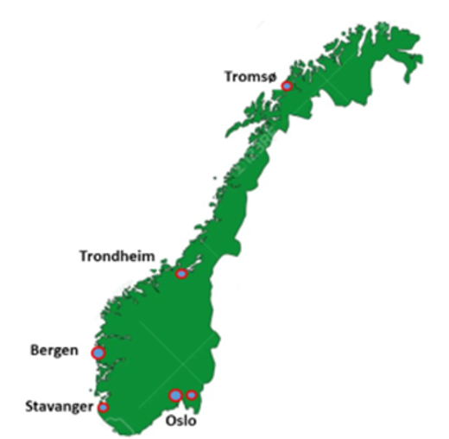
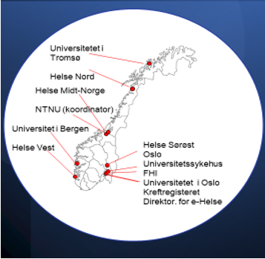
NorCRIN og National Research Networks

Slide 7
NorCRIN Work Packages (WP)
NorCRIN1 WP (funded by partners) 2020-202 AP-ledelse
AP1 | GCP courses | St.Olav
AP3 | Standardise and harmonise monitoring | OUS
AP7 | Early phase units | HUS
AP10 | National couse for study nurses | HUS
NorCRIN2 WP (funded by RCN) 2020-2025 |  | AP-ledelse
AP1 | NorCRIN secretariat/project management | HUS
 | Legislations matters | HUS
 | International collaboration | HUS
AP2 | Standard operating procedures (SOPs) for all types of interventional trials | HUS
AP8 | Data management | OUS
AP9 | Statistics | OUS
AP11 | Infrastructure units | OUS
AP12 | Industry collaboration (NorTrials) | OUS
AP13 | Pragmatic trials | Ahus
AP14 | User involvement | UNN

Slide 8
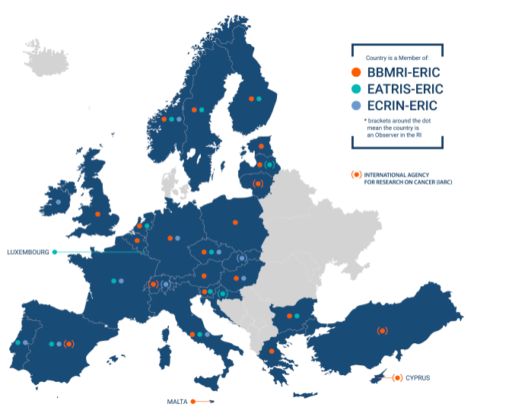


NorCRIN og internasjonale forskningsnettverk
EU-AMRI: European Alliance of Medical Research Infrastructures
BBMRI: Biobank Medicine Research Infrastructure
EATRIS: Translational Medicine Infrastructure
ECRIN: European Clinical Research Infrastructure Network
CRIGH: Clinical Research Initiative for Global Health
WHO: World Health Organization

Slide 9

Local NorCRIN Contacts

Slide 10

NorCRIN Secretariat at Haukeland University Hospital

